Slide 1
Process
An operating system executes a variety of programs:
  Batch system – jobs
  Time-shared systems – user programs or tasks
  Process – a program in execution; process execution must progress in sequential fashion
A process includes:
  program counter
  stack
  data section
Topics:
  Operations in Process
  Scheduling
  Interprocess Communication

Slide 2

Process in Memory

Slide 3
Process State
As a process executes, it changes state
  new: The process is being created
  running: Instructions are being executed
  waiting: The process is waiting for some event to occur
  ready: The process is waiting to be assigned to a processor
  terminated: The process has finished execution

Slide 4

Process States and Transition

Slide 5

Process Control Block (PCB)

Slide 6
Context Switch
When CPU switches to another process, the system must save the state of the old process and load the saved state for the new process via a context switch.
Context of a process represented in the PCB
Context-switch time is overhead; the system does no useful work while switching
Time dependent on hardware support

Slide 7

CPU Switch From Process to Process

Slide 8
Process Creation
Parent process create children processes, which, in turn create other processes, forming a tree of processes
Generally, process identified and managed via a process identifier (pid)
Options in Resource sharing
  Parent and children share all resources
  Children share subset of parent’s resources
  Parent and child share no resources
Options Execution
  Parent and children execute concurrently
  Parent waits until children terminate

Slide 9
Process Creation (Cont.)
Options n Address space
  Child duplicate of parent
  Child has a program loaded into it
UNIX examples
  fork system call creates new process
  exec system call used after a fork to replace the process’ memory space with a new program

Slide 10
Unix Fork/Exec/Exit/Wait Example
int pid = fork();
  Create a new process that is a clone of its parent.
exec*(“program” [, argvp, envp]);
  Overlay the calling process virtual memory with a new program, and transfer control to it.
exit(status);
  Exit with status, destroying the process.
int pid = wait*(&status);
  Wait for exit (or other status change) of a child.
fork parent
fork child
initialize child context
exec
wait
exit

Slide 11
Example: Process Creation in Unix
The fork syscall returns twice: it returns a zero to the child and the child process ID (pid) to the parent.
int pid;
int status = 0;
if (pid = fork()) {
/* parent */
…..
pid = wait(&status);
} else {
/* child */
…..
exit(status);
}
Parent uses wait to sleep until the child exits; wait returns child pid and status.
Wait variants allow wait on a specific child, or notification of stops and other signals.

Slide 12
C Program Forking Separate Process
int main()
{
int pid;
/* fork another process */
pid = fork();
if (pid < 0) { /* error occurred */
fprintf(stderr, "Fork Failed");
exit(-1);
}
else if (pid == 0) { /* child process */
execlp("/bin/ls", "ls", NULL);
}
else { /* parent process */
/* parent will wait for the child to complete */
wait (NULL);
printf ("Child Complete");
exit(0);
}
}

Slide 13
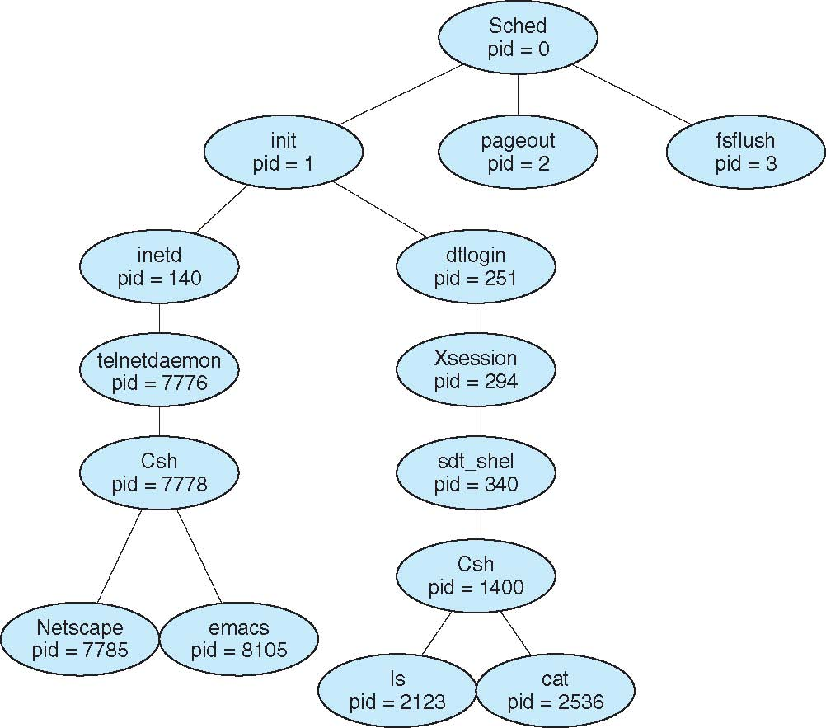
A tree of processes on a typical Solaris

Slide 14
Process Termination
Process executes last statement and asks the operating system to delete it (exit)
  Output data from child to parent (via wait)
  Process’ resources are deallocated by operating system
Parent may terminate execution of children processes (abort)
  Child has exceeded allocated resources
  Task assigned to child is no longer required
  If parent is exiting
    Some operating system do not allow child to continue if its parent terminates
      All children terminated - cascading termination

Slide 15

Communications Models: Shared memory or Message Passing

Slide 16
Synchronization
Message passing may be either blocking or non-blocking
Blocking is considered synchronous
  Blocking send has the sender block until the message is received
  Blocking receive has the receiver block until a message is available
Non-blocking is considered asynchronous
  Non-blocking send has the sender send the message and continue
  Non-blocking receive has the receiver receive a valid message or null

Slide 17

Motivation for multi-threaded servers

Slide 18

Single and Multithreaded Processes

Slide 19
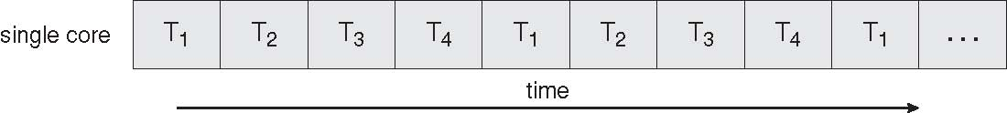
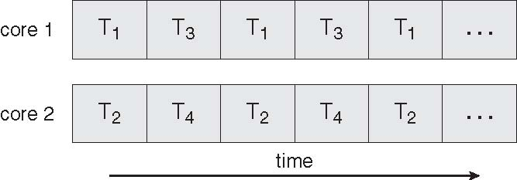
Benefits
Responsiveness
Resource Sharing
Economy
Scalability

Slide 20
Kernel Threads
Recognized and supported by the OS Kernel
OS explicitly performs scheduling and context switching of kernel threads
Examples
  Windows XP/2000
  Solaris
  Linux
  Tru64 UNIX
  Mac OS X

Slide 21
User Threads
Thread management done by user-level threads library
  OS kernel does not know/recognize there are multiple threads running in a user program.
  The user program (library) is responsible for scheduling and context switching of its threads.
Three primary thread libraries:
  POSIX Pthreads
  Win32 threads
  Java threads

Slide 22
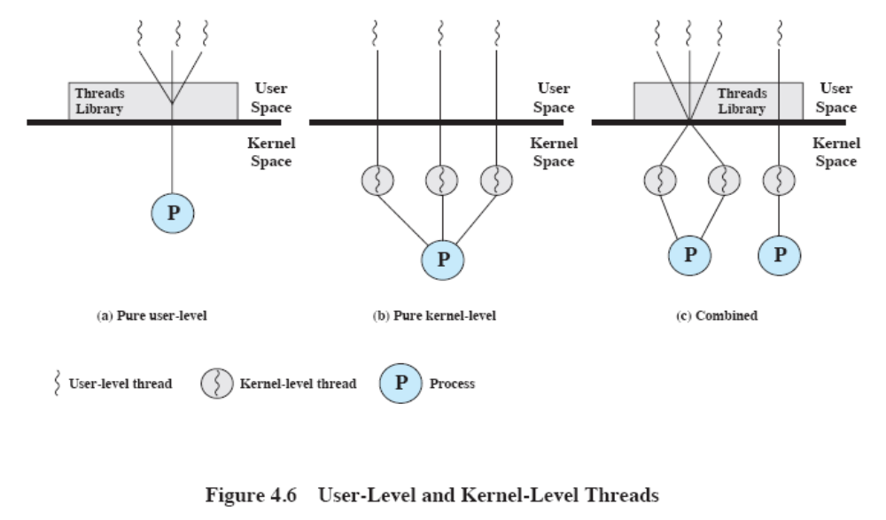
User- vs. Kernel-level Threads
From W. Stallings, Operating Systems, 6th Edition

Slide 23
Pthreads
May be provided either as user-level or kernel-level
A POSIX standard (IEEE 1003.1c) API for thread creation and synchronization
API specifies behavior of the thread library, implementation is up to development of the library
Common in UNIX operating systems (Solaris, Linux, Mac OS X)

Slide 24
Java Threads
Java threads are managed by the JVM
Typically implemented using the threads model provided by underlying OS
Java threads may be created by:
  Extending Thread class
  Implementing the Runnable interface

